Slide 1
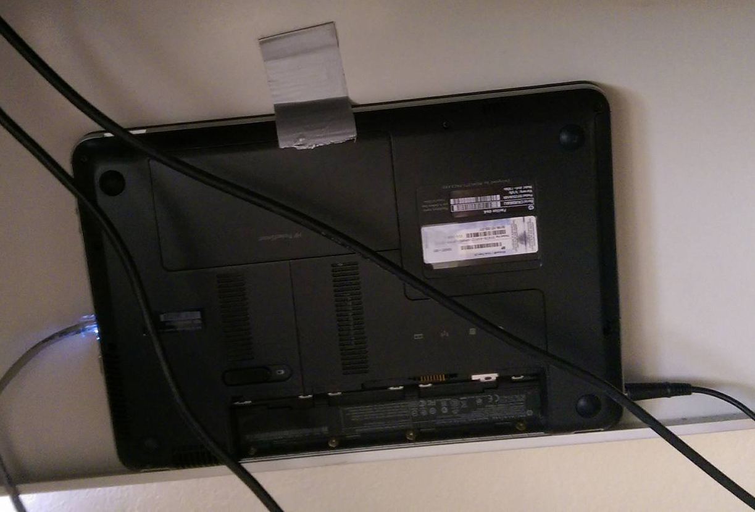
Server Setup
Installed MySQL
Created a single profile with limited privileges for everyone on the team
Installed SSH
Created an account for each member on the team
Installed Node.js
Port Forwarding
Our “Rack Mounted” Server

Slide 2
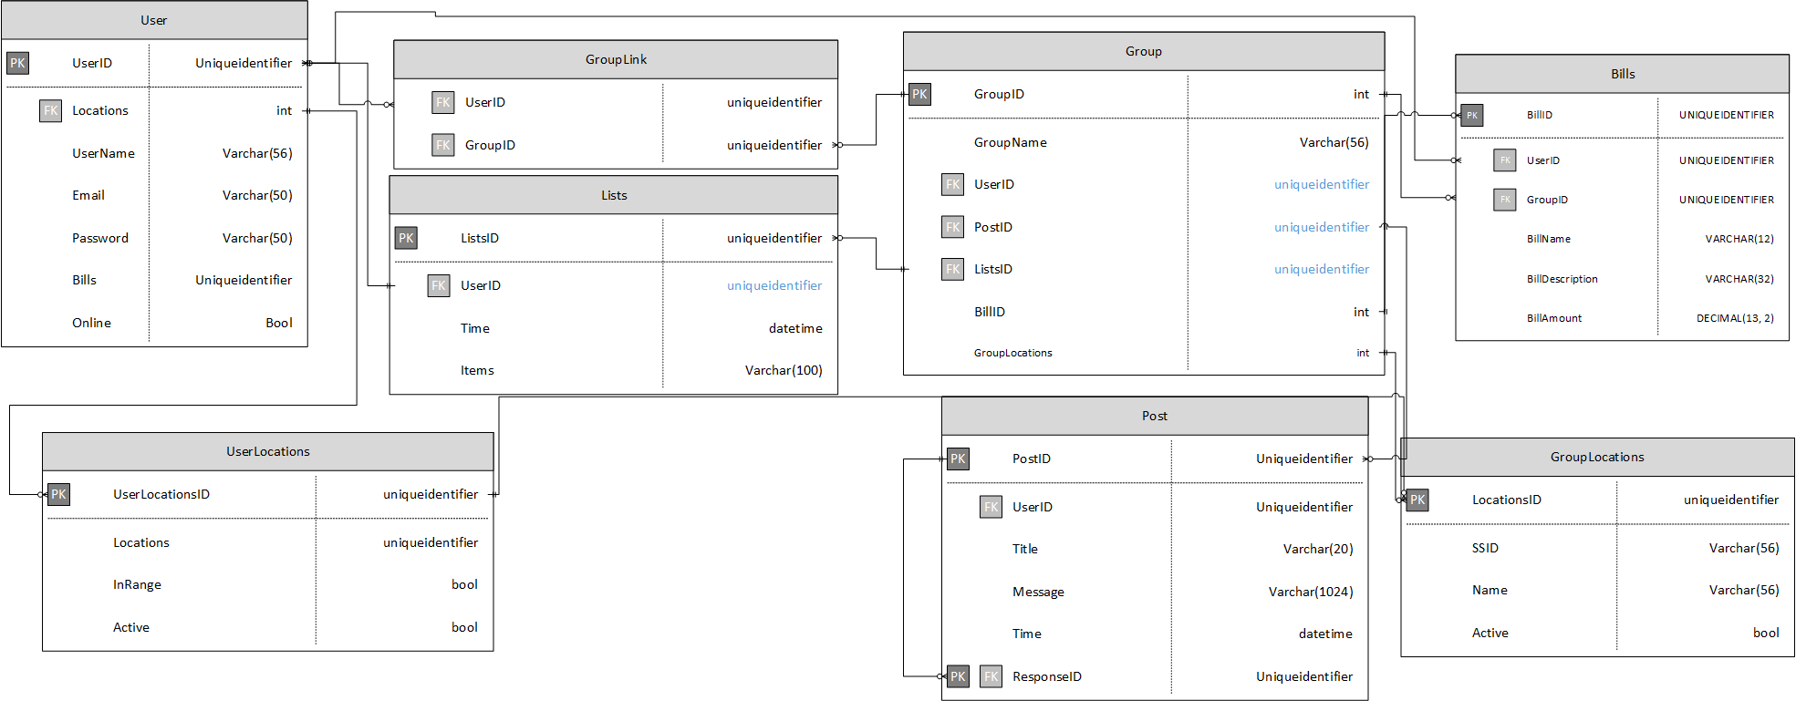
Database Creation Script
4 iterations
First was basic representation of database
Second added constraints to certain columns
Third Fixed some incorrect tables (Locations) changed Password from varchar(32) to CHAR(64) for 256 bit encryption
Fourth Changed INT to BIGINT for UserID’s and GroupID’s

Slide 3
User Interaction Script
Python Script to insert database values based on user workflow
Multi-threaded
Can simulate multiple users

